Slide 1


Smart Automatic Medicine Dispenser with Mobile App Integration.
Presented By- Harshit Khanna

Slide 2
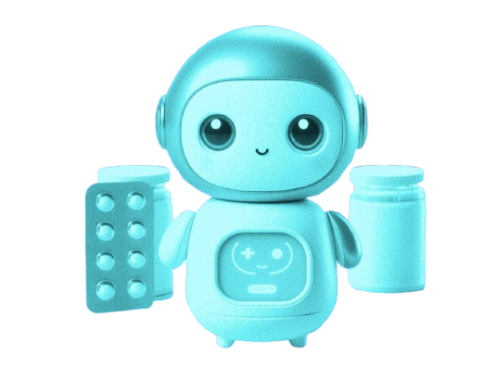

Introduction
Medication adherence is crucial, especially for the elderly and those with chronic conditions. Missed doses can lead to serious health issues. The "Smart Automatic Medicine Dispenser with Mobile App Integration" automates medication dispensing and provides real-time notifications through a mobile app. This system ensures timely doses, improves adherence, and allows caregivers to monitor remotely, enhancing patient safety and convenience.

Slide 3
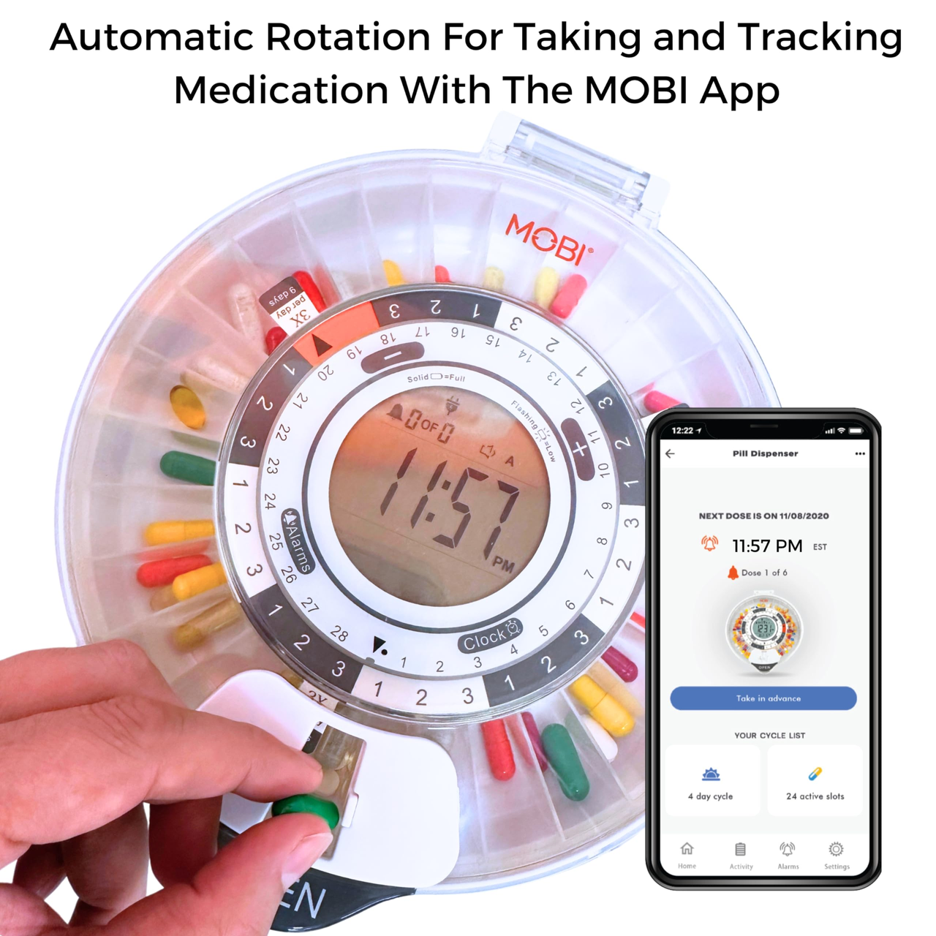
Problem Statement
Ensuring timely and accurate medication intake is a significant challenge for individuals, especially the elderly and those with chronic conditions. Manual medication management can lead to missed doses and incorrect dosages. Caregivers also face difficulties in monitoring medication schedules. There is a need for a solution that simplifies this process and enhances adherence through automation and remote accessibility.

Slide 4
Methodology
This project follows a multidisciplinary approach, integrating hardware, software, and IoT technologies.
Hardware
Software
IoT
The dispenser uses a microcontroller to control a motorized system for precise dosing, with sensors monitoring medication levels and triggering refill alerts when needed.
The mobile app connects with the dispenser via IoT, allowing notifications, and tracking usage patterns through an intuitive interface.
The IoT functionality enables seamless communication between the mobile app and dispenser, allowing real-time data exchange for dose scheduling and monitoring.

Slide 5
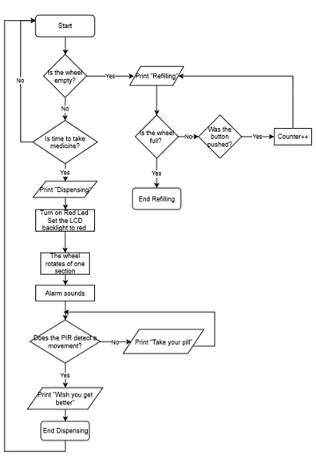
Process
The system dispenses medication based on scheduled times, while the mobile app tracks usage and sends real-time notifications via IoT communication with the dispenser.

Slide 6
Algorithm
1. Initialize RTC and Servo
2. Main loop
Get current time from RTC.
If second changes, print time.
For each target time, check if hour and minute match.
If match and second is 0, rotate servo and set action flag.
Reset action flag if second is not zero.
If RTC not found, print error and halt.
If RTC lost power, set RTC time to compile time.
Initialize servo position to 0 degrees.
3. Servo Rotation
4. Delay
Increment servo position by 45 degrees.
If position exceeds 180 degrees, reset to 0.
Move servo to new position.
There should be short delay for better working of the model.

Slide 7
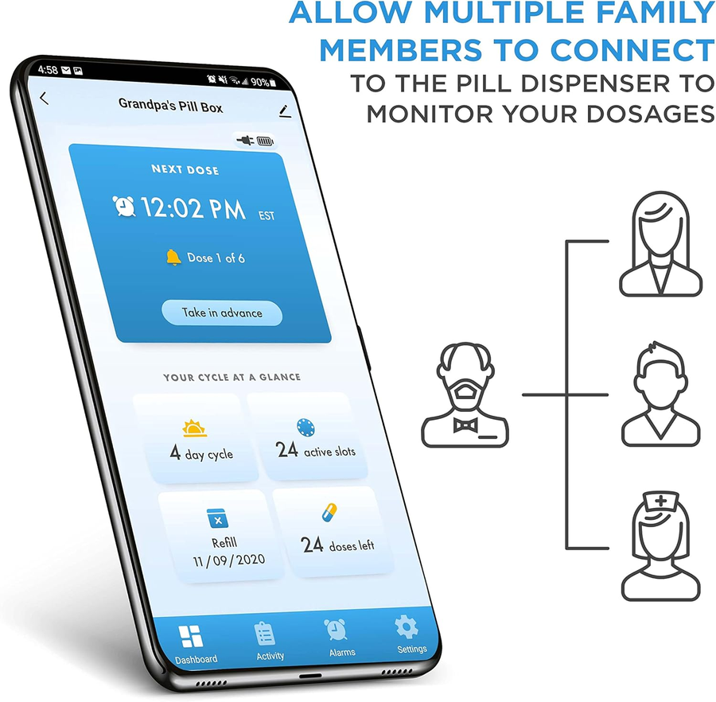
Result
The prototype successfully demonstrates the core functionalities:
1. Precision Dispensing: Medicines are dispensed accurately and on time.
2. Seamless Connectivity: Real-time synchronization between the app and dispenser ensures smooth operation.
3. Enhanced User Experience: The app's user-friendly design makes it accessible for all age groups.

Slide 8

Discussions
The prototype demonstrates IoT's potential in healthcare, reducing human error and improving medication adherence. However, connectivity issues may delay real-time updates, affecting adherence. Future improvements include adding local storage and optimizing data transfer for low-bandwidth areas. Reducing hardware costs is also a focus to enhance affordability for lower-income regions. Research into more affordable components will help address these challenges.

Slide 9
Using AI to predict medication patterns and improve adherence.
Adding voice commands for better accessibility.
Voice Assistance
AI Integration
Future Work
Advanced Sensors
Implementing sensors for temperature and humidity to preserve medication efficacy.

Slide 10
Conclusion
The Smart Medicine Dispenser with Mobile App Integration offers a practical solution for improving medication adherence. By automating the dispensing process and providing real-time updates, it reduces the likelihood of errors and improves patient outcomes.
Presented By- Harshit Khanna

